Slide 1


BACHELOR OF TECHNOLOGY
IN
Artificial Intelligence and Machine Learning
Project Guide:Prof.Manoj Sagar Batch Names & Roll Numbers
Batch Number :ZT4 R.Srilekha-2111CS020559
D.Srinath-2111CS020560
G.Srinidhi-2111CS020561
P.Srinika-2111CS020562
A.Sripada sai venkata Yuktheswar-2111CS020564
Sriram Manikumar-2111CS020565
Department of AIML, School of Engineering
Malla Reddy University Hyderabad.

Slide 2
Contours and Colors:
The Science of Image Segmentation!

Slide 3
PROBLEM STATEMENT
“The problem statement of image segmentation involves dividing an image
into meaningful and semantically interpretable segments or regions. The
primary goal is to assign a label to each pixel or group of pixels in an image,
effectively creating a map that identifies different objects or areas within the image.
Image segmentation is a fundamental task in computer vision and is crucial for
various applications."

Slide 4
ABSTRACT
Image segmentation, a cornerstone of computer vision, has been revolutionized through the application of machine learning techniques. This abstract provides an encompassing overview of diverse segmentation methodologies within this framework. From region-based techniques like watershed segmentation, which accurately separates overlapping cells in microscopic images, to edge-based methods such as Canny edge detection that enhance object boundaries for pedestrian detection in surveillance, and further to clustering segmentation exemplified by K-means clustering, effectively categorizing land cover types in satellite imagery. The abstract culminates in the prominence of deep learning, embodied by Mask R-CNN, which excels in instance segmentation, enabling precise detection and pixel-level masking of diverse objects in complex scenes

Slide 5
DATA SET DESCRIPTION
Our dataset, consists of 11M diverse, high-resolution, licensed, and privacy protecting images and 1.1B high-quality segmentation masks collected with our data engine. We compare segment anything model with existing datasets and analyze mask quality and properties. We developed the model to aid future development of foundation models for computer vision.
Images: We licensed a new set of 11M images from a provider that works directly with photographers. These images are high resolution (3300×4950 pixels on average), and the resulting data size can present accessibility and storage challenges. Therefore, we developed down-sampled images with their shortest side set to 1500 pixels.
Masks: Our data engine produced 1.1B masks, 99.1% of which were generated fully automatically. Therefore, the quality of the automatic masks is centrally important. We compare them directly to professional annotations and look at how various mask properties compare to prominent segmentation datasets.

Slide 6
DATA PRE PROCESSING TECHNIQUES
We perform zero-shot and few-shot learning for dataset. we build a “data engine”, i.e., we iterate between using our efficient model to assist in data collection and using the newly collected data to improve the model. We introduce each interconnected component next, followed by the dataset we created and the experiments that demonstrate the effectiveness of our approach.
The data engine has three stages: (1) a model-assisted manual annotation stage, (2) a semi-automatic stage with a mix of automatically predicted masks and model-assisted annotation, and (3) a fully automatic stage in which our model generates masks without annotator input.

Slide 7
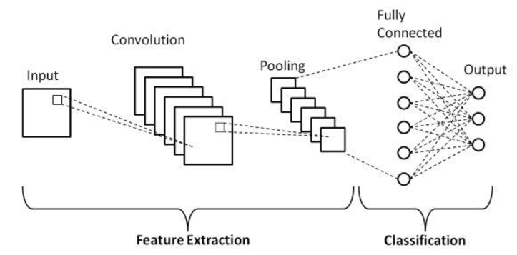
MODEL SELECTION-MODEL DEVELOPMENT
SOFTWARE REQUIREMENTS
CNNs(Convolutional Neural Networks), Mask R-CNN(Region based Convolutional Neural Network).
SOFTWARE REQUIREMENTS
Python >= 3.8, pytorch >= 1.7, torchvision >= 0.8, open_cvpython, Matplotlib, SAM model and Model checkpoint.
HARDWARE REQUIREMENTS
GPU(Graphic Processing Unit), sufficient storage, internet connection, cuda compatibility.

Slide 8
MODEL TRAINING & TESTING
We co-develop our model with model-in-the-looped dataset annotation. Our data engine has three stages : assisted-manual, semi-automatic, and fully automatic. In the first stage, SAM assists annotators in annotating masks, similar to a classic interactive segmentation setup. In the second stage, SAM can automatically generate masks for a subset of objects by prompting it and annotators focus on annotating the remaining objects, helping increase mask diversity. In the final stage, we prompt SAM with a regular grid of foreground points, yielding on average ∼100 high-quality masks per image.

Slide 9
MODEL EVALUATION METRICS
We evaluated SAM on a variety of metrics based on the downstream task in our experiments.
mIoU: We used the mean intersection-over-union after a given number of prompts to evaluate the segmentation quality of a mask when prompted with points.
Human evaluation: We compared the masks generated by SAM to a baseline state-of-the-art interactive segmentation model, using a perceptual quality scale from 1 to 10.
AP: We used average precision to evaluate instance segmentation for a edge detection.
AR@1000: We used average recall to evaluate object proposal generation.
ODS, OIS, AP, R50: We used the standard edge detection evaluation metrics from BSDS500 [72, 3].

Slide 10
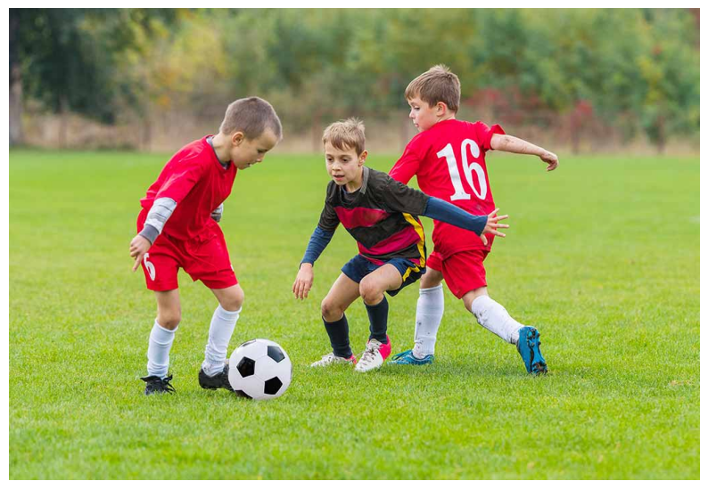
APPLICATION INTEGRATION &
MODEL INTEGRATION
INPUT:

Slide 11
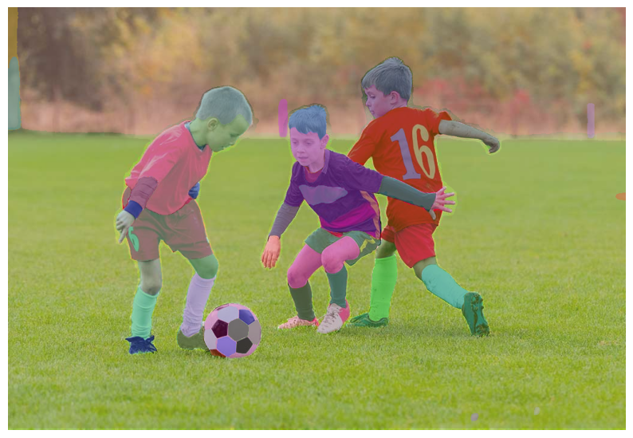
OUTPUT:

Slide 12
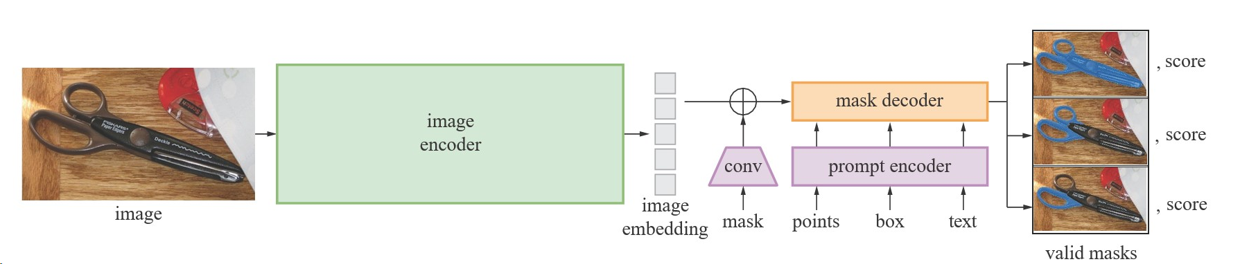
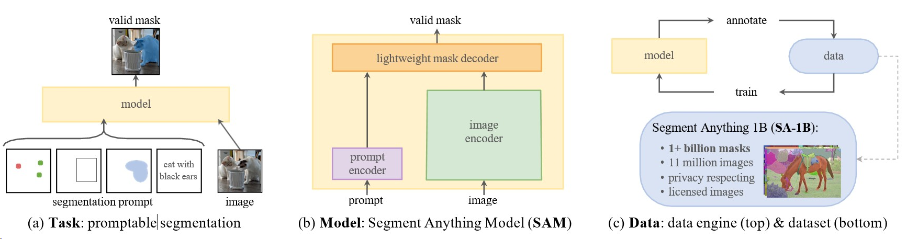

Slide 13










THE TEAM
THANK YOU
WE ARE OPEN FOR QUERIES

